Slide 1

Data Analysis Portfolio
Mr. Rahul Vishwakarma

Slide 2




Data Analysis Portfolio
Mr. Rahul Vishwakarma

Slide 3
Introduction
Sales professional transitioning to Data Analyst with expertise in SQL, Power BI, Excel, and Python. Skilled in analyzing financial data, creating interactive dashboards, and delivering actionable insights. Proven ability to transform complex data into clear reports, driving informed business decisions through data-driven strategies.

Slide 4
Academic Credentials
Educational Background :–
• Bachelor's Degree in Political Science
• Graduated in 2021
Skills :-
• Data Analysis
• Data Visualization
• SQL
• Microsoft Excel
• Microsoft Office
• Leadership
• Effective Communication
• Analytical and Problem Solving Skills

Slide 5
Project 1 :Data Analytics Process
Presented By : Rahul Vishwakarma

Slide 6
Application in Real Life Scenario Case Study
Description:
We use Data Analytics in everyday life without even knowing it.
Task :
To Provide an example or examples of real-life situations where Data Analytics is utilized, and
connect it with the Data Analytics process.

Slide 7
Project Approach
Description
A marriage is happening next month. According to that, the planning can be done.
Plan
We have to decide the marriage date by both families.
Then decide the venue of marriage
Planning for all ceremonies including engagement, mehendi , sangeet, wedding, and reception.
How much money needed for marriage means budget and Gift Exchange.
Prepare
Prepare the Guest List on which day guest will arrive. Making of Guest list.
Types of food served in marriage, selection of food vendor.
Which outfit ,dresses, jewellery design, photographers, decorators, DJs, and makeup artists Required in marriage.
Room and any hotels for guest Stay and vehicles required in marriage

Slide 8
Project Description and Conclusion
Process
In marriage how many event are there. Deciding the flow of event, On which day Engagement, mehendi, sangeet , wedding and reception will done.
On Mehendi and sangeet day which dance , speech and function will performed.
How marriage rituals performed step by step.
Which food is served on which event from starter to main course including snacks, Drinks, desserts, cuisines.
Analyze
Analyze the venue place is far or it is near by railway station, bus stop or by walking.
Ensuring the venue is successfully is booked also in budget.
Ensuring hotels are booked and some room get on rent.
Monitoring the budget and avoiding the over spending.
Food vender is booked and list of dishes meets the requirements of guest.
Taking review form guest about services and all the planning and prepare for any unavoidable circumstances.
Comparing the prices for different food venders, DJs, make artist, etc.
Share
Sending the physical wedding card, digitally on whatsapp, google map location etc.
Sharing the Roles for each family for welcoming the guest, for all event, who will take care of all food arrangements.
Act
The bride and groom get married and All the guest enjoyed the marriage.
All event like engagement, mehindi, sangeet, reception happened as planned.
After the wedding, ensure all vendors are paid.

Slide 9
Project : Marriage Selection using Data Analytic
Description
Utilized data analytics to plan and execute a wedding by analyzing budgets, vendors, guest preferences, and event schedules to ensure a smooth and successful celebration.
Approach
Collected requirements from both families to finalize the date, venue, and ceremonies (engagement, mehendi, sangeet, wedding, and reception.
Prepared guest lists, food menus, outfits, vendor details, hotel bookings, and travel arrangements.
Designed the event flow, food schedule, and rituals while analyzing location accessibility, vendor prices, and budget constraints.
Monitored expenses, compared options, gathered feedback, and shared invitations and roles digitally and physically.
Outcome
Successfully executed the wedding events as per the planned schedule.
Optimized budget and vendor selection through data-driven comparisons.
Ensured high guest satisfaction with timely arrangements and service quality.
Demonstrated the practical application of data analytics for real-life event planning.

Slide 10

Thank You

Slide 11

Instagram User Analytics
Presented By : Rahul Vishwakarma

Slide 12
Company Overview
My role involves analyzing user interactions and engagement with the Instagram app to provide valuable insights that can help the business grow.
User analysis involves tracking how users engage with a digital product, such as a software application or a mobile app. The insights derived from this analysis can be used by various teams within the business.
The marketing team might use these insights to launch a new campaign, the product team might use them to decide on new features to build, and the development team might use them to improve the overall user experience.

Slide 13
Marketing Analysis

Slide 14
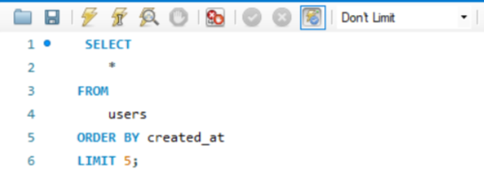

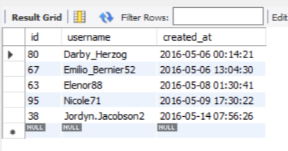
The marketing team wants to reward the most loyal users, i.e., those who have been using the platform for the longest time.
Loyal User Reward
Identify the five oldest users on Instagram from the provided database.
SELECT
*
FROM
users
ORDER BY created_at
LIMIT 5;

Slide 15
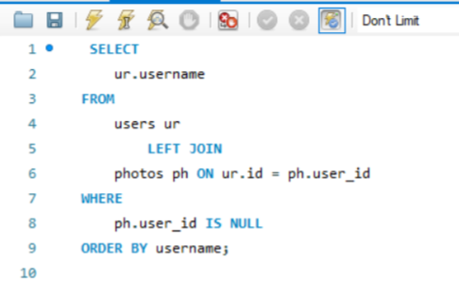

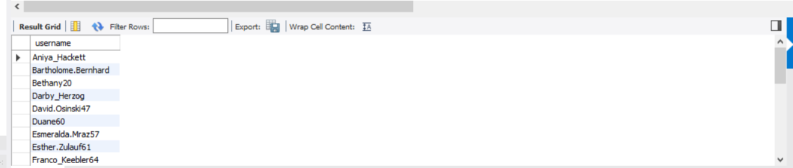
Identify users who have never posted a single photo on Instagram.
Inactive User Engagement
The team wants to encourage inactive users to start posting by sending them promotional emails.
SELECT
ur.username
FROM
users ur
LEFT JOIN
photos ph ON ur.id = ph.user_id
WHERE
ph.user_id IS NULL
ORDER BY username;

Slide 16
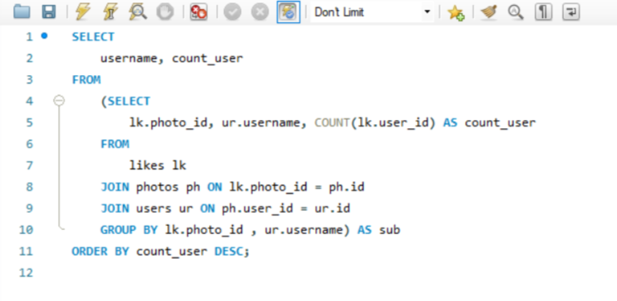

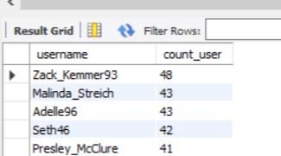
The team has organized a contest where the user with the most likes on a single photo wins.
Contest Winner Declaration
Determine the winner of the contest and provide their details to the team.
SELECT username ,count_user
FROM (
SELECT
lk.photo_id,
ur.username,
COUNT(lk.user_id) AS count_user
FROM likes lk
JOIN photos ph ON lk.photo_id = ph.id
JOIN users ur ON ph.user_id = ur.id
GROUP BY lk.photo_id, ur.username
) AS sub
ORDER BY count_user DESC;

Slide 17
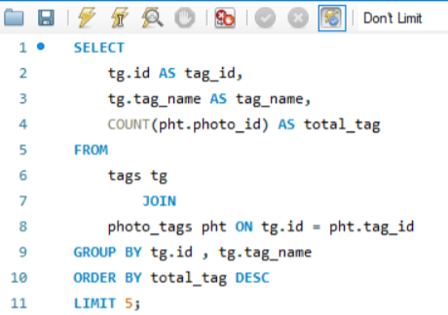

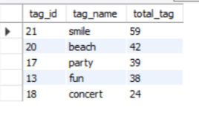
A partner brand wants to know the most popular hashtags to use in their posts to reach the most people.
Hashtag Research
Identify and suggest the top five most commonly used hashtags on the platform.
SELECT
tg.id AS tag_id,
tg.tag_name AS tag_name,
COUNT(pht.photo_id) AS total_tag
FROM
tags tg
JOIN
photo_tags pht ON tg.id = pht.tag_id
GROUP BY tg.id , tg.tag_name
ORDER BY total_tag DESC
LIMIT 5;

Slide 18
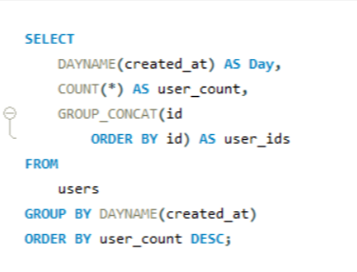
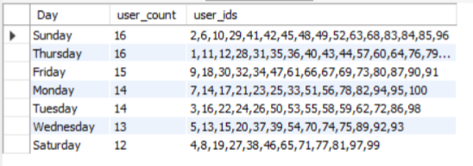
The team wants to know the best day of the week to launch ads.
Ad Campaign Launch
Determine the day of the week when most users register on Instagram. Provide insights on when to schedule an ad campaign.
SELECT
DAYNAME(created_at) AS Day,
COUNT(*) AS user_count,
GROUP_CONCAT(id
ORDER BY id) AS user_ids
FROM
users
GROUP BY DAYNAME(created_at)
ORDER BY user_count DESC;

Slide 19
Investor Metrics

Slide 20
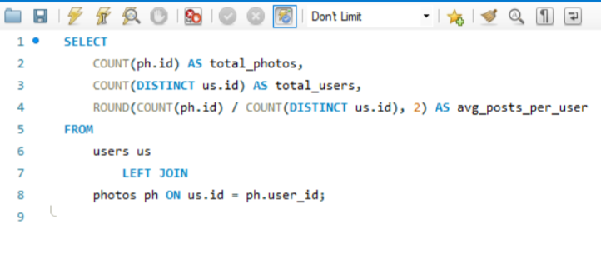
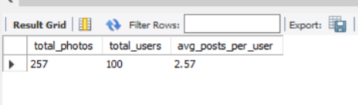
Investors want to know if users are still active and posting on Instagram or if they are making fewer posts.
User Engagement
Calculate the average number of posts per user on Instagram.
SELECT
COUNT(ph.id) AS total_photos,
COUNT(DISTINCT us.id) AS total_users,
ROUND(COUNT(ph.id) / COUNT(DISTINCT us.id), 2) AS avg_posts_per_user
FROM
users us
LEFT JOIN
photos ph ON us.id = ph.user_id;

Slide 21
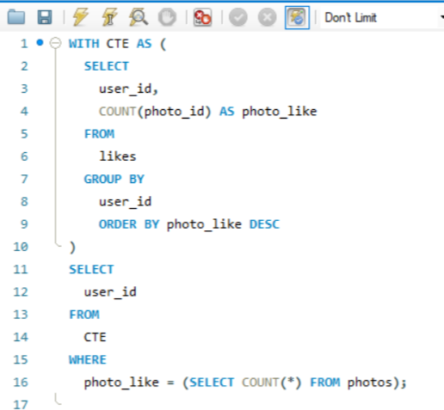

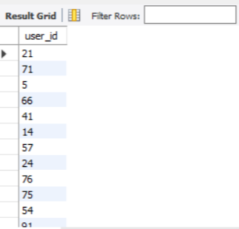
Investors want to know if the platform is crowded with fake and dummy accounts.
Bots & Fake Accounts
Calculate the average number of posts per user on Instagram.
WITH CTE AS (
SELECT
user_id,
COUNT(photo_id) AS photo_like
FROM
likes
GROUP BY
user_id
ORDER BY photo_like DESC
)
SELECT
user_id
FROM
CTE
WHERE
photo_like = (SELECT COUNT(*) FROM photos);

Slide 22
Thank You

Slide 23
Operation Analytics and Investigating Metric Spike
Presented By : Rahul Vishwakarma

Slide 24
Description
Operational Analytics is a crucial process that involves analyzing a company's end-to-end operations. This analysis helps identify areas for improvement within the company. As a Data Analyst, My work closely with various teams, such as operations, support, and marketing, helping them derive valuable insights from the data they collect.
One of the key aspects of Operational Analytics is investigating metric spikes. This involves understanding and explaining sudden changes in key metrics, such as a dip in daily user engagement or a drop in sales.

Slide 25
Job Data Analysis

Slide 26
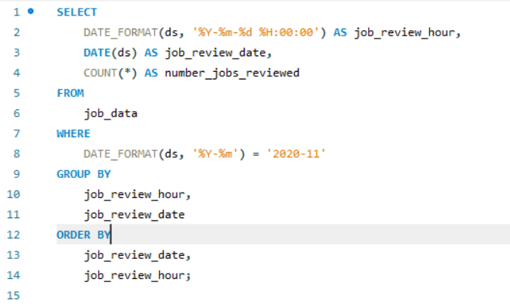

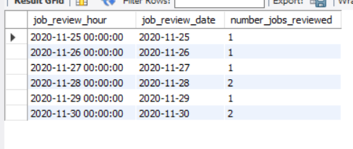
Calculate the number of jobs reviewed per hour for each day in November 2020.
Jobs Reviewed Over Time
SELECT
DATE_FORMAT(ds, '%Y-%m-%d %H:00:00') AS job_review_hour, DATE(ds) AS job_review_date,
COUNT(*) AS number_jobs_reviewed
FROM job_data
WHERE DATE_FORMAT(ds, '%Y-%m') = '2020-11’
GROUP BY job_review_hour, job_review_date
ORDER BY job_review_date, job_review_hour;
Jobs were reviewed steadily hour by hour each day in November 2020, showing a consistent workflow without major spikes. This suggests balanced staffing or well-paced review scheduling, allowing for efficient allocation of resources and minimizing bottlenecks in daily operations. Patterns can inform future process improvements.

Slide 27
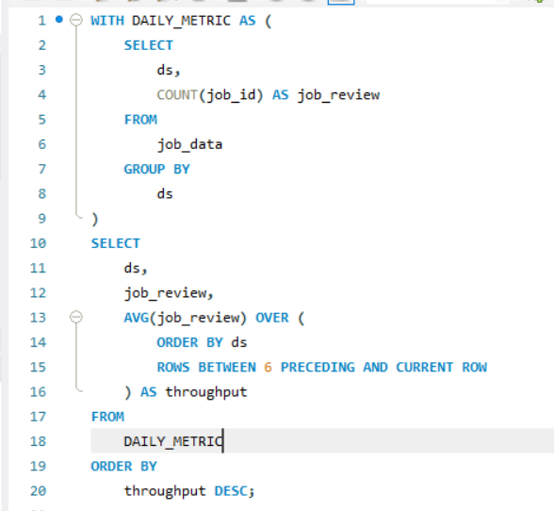
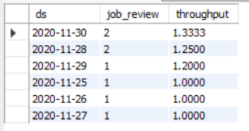
Calculate the 7-day rolling average of throughput (number of events per second).
Throughput Analysis
Write an SQL query to calculate the 7-day rolling average of throughput. Additionally, explain whether you prefer using the daily metric or the 7-day rolling average for throughput, and why.
WITH DAILY_METRIC AS
( SELECT ds, COUNT(job_id) AS job_review
FROM job_data
GROUP BY ds)
SELECT ds, job_review, AVG(job_review)
OVER ( ORDER BY ds ROWS BETWEEN 6 PRECEDING AND CURRENT ROW ) AS throughput
FROM DAILY_METRIC
ORDER BY throughput DESC;
I recommend using the 7-day rolling average for most analysis and long-term analysis, and the daily metric for monitoring and alerting.

Slide 28
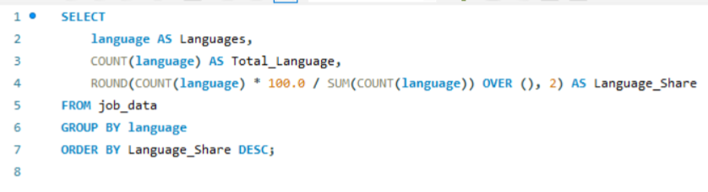
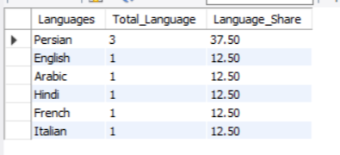
Calculate the percentage share of each language in the last 30 days. Write an SQL query to calculate the percentage share of each language over the last 30 days.
Language Share Analysis:
SELECT language AS Languages,
COUNT(language) AS Total_Language,
ROUND(COUNT(language) * 100.0 / SUM(COUNT(language)) OVER (), 2) AS Language_Share
FROM
job_data
GROUP BY language
ORDER BY Language_Share DESC;
The query shows which languages are most common in job data. Persian is the most popular, with 37.5% share, while other languages like English, Arabic, and Hindi each have 12.5%. This helps us see which languages are most needed, helping companies focus on those for job postings.

Slide 29
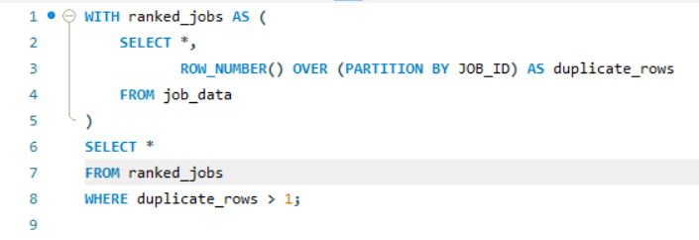
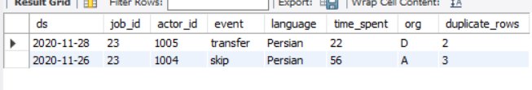
Identify duplicate rows in the data. Write an SQL query to display duplicate rows from the job_data table.
Duplicate Rows Detection
WITH ranked_jobs AS
( SELECT *, ROW_NUMBER() OVER (PARTITION BY JOB_ID) AS duplicate_rows
FROM job_data)
SELECT *
FROM ranked_jobs
WHERE duplicate_rows > 1;
The query helps find duplicate job entries in the data. By using the row number function and filtering for duplicates, we can easily see which jobs appear more than once. This helps companies clean their database, avoid mistakes, and keep their job records accurate and organized.

Slide 30
Investigating Metric Spike

Slide 31
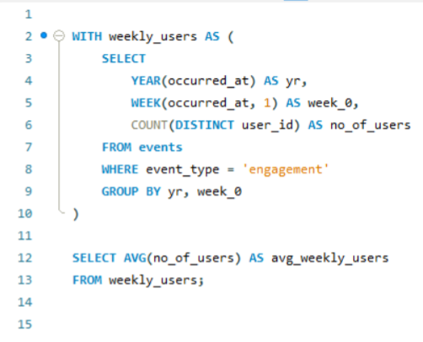
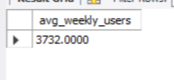
Measure the activeness of users on a weekly basis
Weekly User Engagement
Write an SQL query to calculate the weekly user engagement.
WITH weekly_users AS
( SELECT YEAR(occurred_at) AS yr,
WEEK(occurred_at, 1) AS week_0,
COUNT(DISTINCT user_id) AS no_of_users
FROM events
WHERE event_type = 'engagement'
GROUP BY yr, week_0)
SELECT AVG(no_of_users) AS avg_weekly_users
FROM weekly_users;
The query finds the average number of users who engaged every week, which is about 3,732. This number helps the company understand its weekly activity. If the number goes up, more people are using the platform. If it drops, they may need to find ways to boost user engagement.

Slide 32
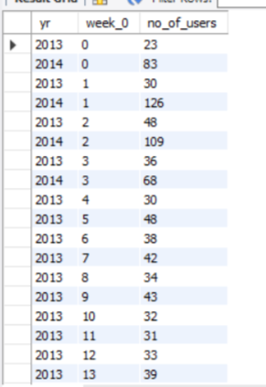
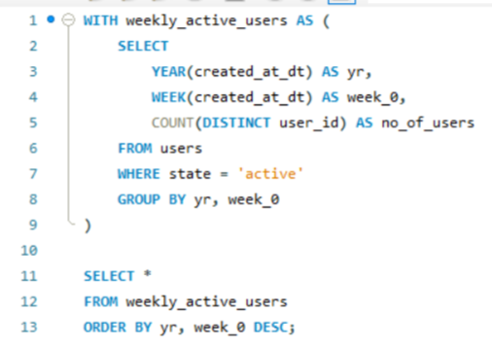
Analyze the growth of users over time for a product
User Growth Analysis
Write an SQL query to calculate the user growth for the product.
WITH weekly_active_users AS
( SELECT YEAR(created_at_dt) AS yr,
WEEK(created_at_dt) AS week_0,
COUNT(DISTINCT user_id) AS no_of_users
FROM users
WHERE state = 'active'
GROUP BY yr, week_0)
SELECT *FROM weekly_active_users
ORDER BY yr, week_0 DESC;
Every week, we count how many users are active on the platform. By checking user activity, the company can see if more people are joining or leaving. This helps them understand user trends and know when to improve features or bring new users to keep the platform growing.

Slide 33
Analyze the retention of users on a weekly basis after signing up for a product.
Weekly Retention Analysis
Write an SQL query to calculate the weekly retention of users based on their sign-up cohort.
WITH weekly_active_users AS
( SELECT YEAR(created_at_dt) AS yr,
WEEK(created_at_dt) AS week_0,
COUNT(DISTINCT user_id) AS no_of_users
FROM users
WHERE state = 'active'
GROUP BY yr, week_0)
SELECT *FROM weekly_active_users
ORDER BY yr, week_0 DESC;
The data shows the number of unique active users each week. We can see big changes week to week, with some weeks having over 100 users while others are much lower. This means user activity is not steady and may depend on events or specific factors during those weeks.

Slide 34
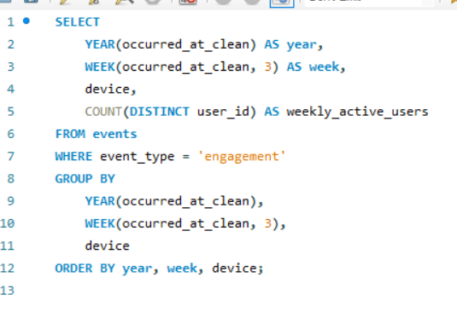
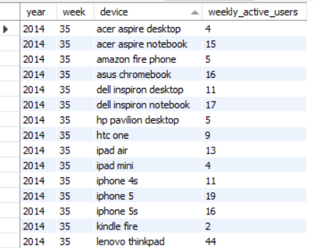
Measure the activeness of users on a weekly basis per device.
Weekly Engagement Per Device
Write an SQL query to calculate the weekly engagement per device.
SELECT
YEAR(occurred_at_clean) AS year,
WEEK(occurred_at_clean, 3) AS week,
device,
COUNT(DISTINCT user_id) AS weekly_active_users
FROM events
WHERE event_type = 'engagement’
GROUP BY YEAR(occurred_at_clean), WEEK(occurred_at_clean, 3), device
ORDER BY year, week, device;
The query counts how many different users are active each week on different devices. This helps the company see which devices are most popular and when people use them most. Tracking weekly active users by device helps plan updates, fix issues, and make sure the platform works well for everyone.

Slide 35
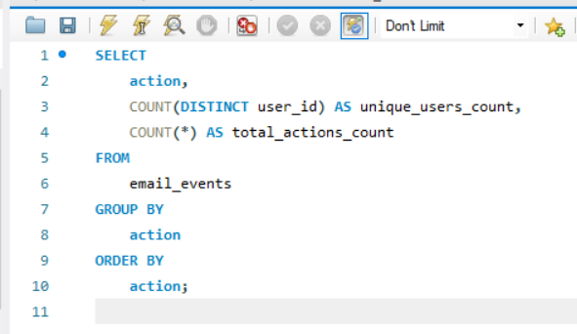
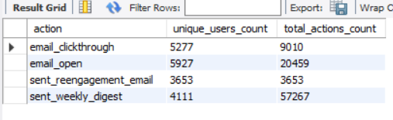
Analyze how users are engaging with the email service.
Email Engagement Analysis
Write an SQL query to calculate the email engagement metrics.
SELECT
action,
COUNT(DISTINCT user_id) AS unique_users_count,
COUNT(*) AS total_actions_count
FROM email_events
GROUP BY action
ORDER BY action;
The data shows user actions on emails. Most users opened emails (5927 users, 26459 actions), meaning some opened multiple times. Weekly digests had 4111 users but a high total count (57627), showing repeated engagement. Clickthroughs were fewer (5727 users, 9019 actions), suggesting many open emails but fewer click on links.

Slide 36
Thank You

Slide 37
Hiring Process Analytics
Presented By : Rahul Vishwakarma

Slide 38
Description
My task is to analyze the company's hiring process data and draw meaningful insights from it. The hiring process is a crucial function of any company, and understanding trends such as the number of rejections, interviews, job types, and vacancies can provide valuable insights for the hiring department.

Slide 39
Approach
Handling Missing Data: Check if there are any missing values in the dataset. If there are, decide on the best strategy to handle them.
Clubbing Columns: If there are columns with multiple categories that can be combined, do so to simplify your analysis.
Outlier Detection: Check for outliers in the dataset that may skew your analysis.
Removing Outliers: Decide on the best strategy to handle outliers. This could be removing them, replacing them, or leaving them as is, depending on the situation.
Data Summary: After cleaning and preparing your data, summarize your findings. This could involve calculating averages, medians, or other statistical measures. It could also involve creating visualizations to better understand the data.

Slide 40
Hiring Process Analytics

Slide 41
DATA CLEANING
In the Event_name there 4 distinct types “Male”, “Female” ,” Don’t want to say”, “-”. This is Categorical data. “- ” changing to “Don’t want to say ”
Application Id 114584 is replace by mean of offered Salary is 51241 because it had “-”
Deleted 4 Row with that contains outliers
Statistical measures
Max Salary = 400000
Min Salary = 100
Median Salary = 49628
Mean Salary = 49983.20
Q1 = 25463
Q3 = 74438
IQR (Interquartile Range) = 48974.25
Upper Bond : 147876
Lower Bond : -48002

Slide 42
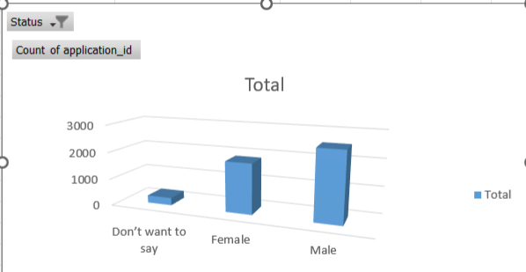
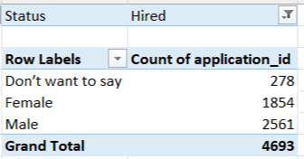
Determine the gender distribution of hires. How many males and females have been hired by the company?

Slide 43
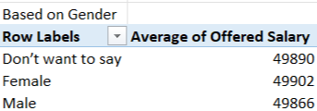
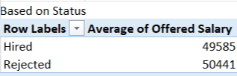
What is the average salary offered by this company? Use Excel functions to calculate this.
“The salary analysis is based on the average offered salaries provided by the company. The overall average offered salary, across all statuses and genders, is ₹49,880. The average salary for candidates actually hired by the company is ₹49,585.”

Slide 44
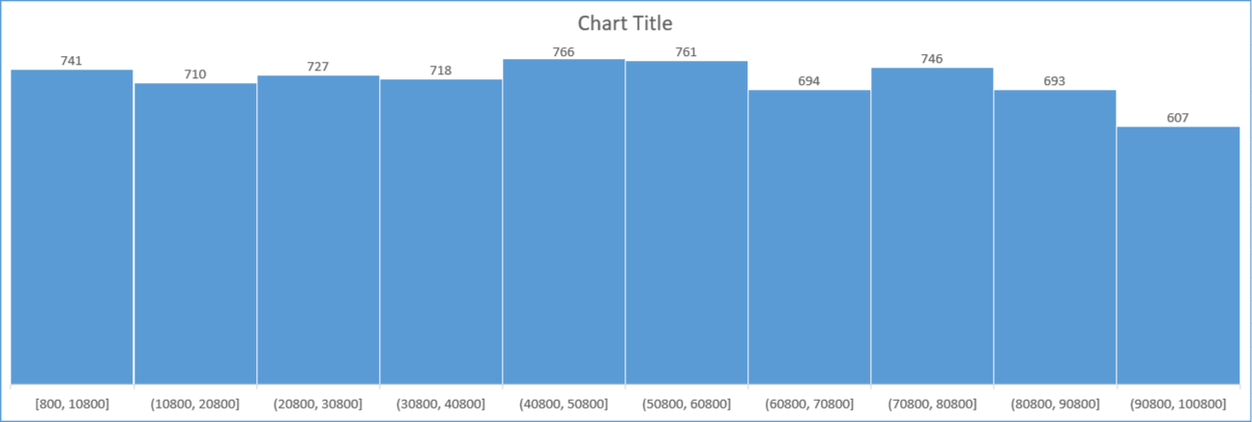
Create class intervals for the salaries in the company. This will help you understand the salary distribution.
The chart above illustrates how offered salaries are distributed across defined salary ranges (class intervals). Each bar represents a salary range, and its height shows how many candidates fall within that range.
The salary ranges start from ₹800 to ₹10,800 and increase in equal intervals of ₹10,000.
The highest frequency occurs in the ₹40,800–₹50,800 and ₹50,800–₹60,800 ranges, with 766 and 761 candidates respectively — indicating that most offered salaries cluster around the mid-range.
The lowest frequency is in the highest salary band, ₹90,800–₹100,800, with 607 candidates, showing fewer high offers.
The distribution appears fairly balanced, with a slight concentration in the mid-salary ranges.
The salary distribution shows a clear mid-range cluster (₹40,800–₹60,800) where most offers fall, fewer candidates in the lowest (₹800–₹10,800) and highest (₹90,800–₹100,800) bands indicating rare low or high offers, and an overall balanced spread suggesting salaries align well with role levels and market standards.

Slide 45
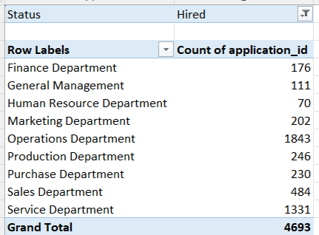
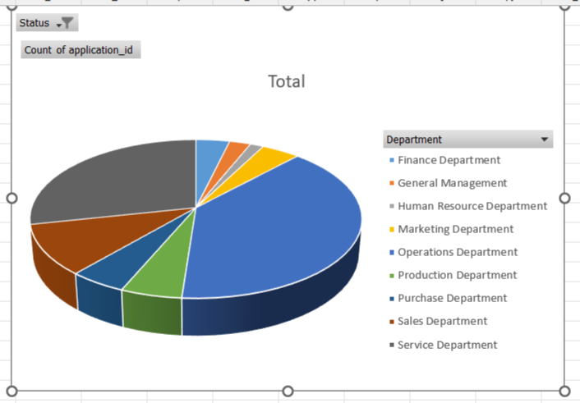
Use a pie chart, bar graph, or any other suitable visualization to show the proportion of people working in different departments.
Most hires are concentrated in the Operations and Service Departments, while departments like HR and General Management have the fewest hires, highlighting where the company’s main workforce demand lies.

Slide 46
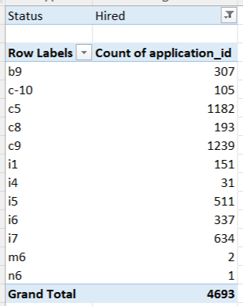
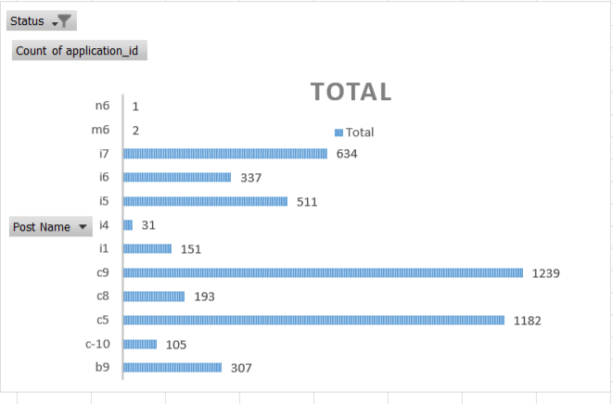
Use a chart or graph to represent the different position tiers within the company. This will help you understand the distribution of positions across different tiers.
Most hires are for posts c5, c9, i7, and i5, showing these positions drive the bulk of recruitment while roles like m6 and n6 have minimal hiring.

Slide 47
Thank You

Slide 48
IMDB Movie Analysis
PROJECT DESCRIPTION :
The IMDB Movie Analysis project is designed to explore and examine a rich dataset of movies sourced from the IMDb platform. This dataset includes key details such as directors, movie titles, duration, genres, budgets, gross earnings,
IMDb ratings, and more. By applying in-depth data analysis, data visualization, and statistical techniques in Excel, the project aims to uncover meaningful insights and trends that help explain what drives a movie’s success.
As part of this project, I was tasked with preparing a detailed report for the provided data record, addressing the questions that follow.

Slide 49
Data Analytics Tasks
Movie Genre Analysis: Analyze the distribution of movie genres and their impact on the IMDB score.
Task: Determine the most common genres of movies in the dataset. Then, for each genre, calculate descriptive statistics (mean, median, mode, range, variance, standard deviation) of the IMDB scores.
Movie Duration Analysis: Analyze the distribution of movie durations and its impact on the IMDB score.
Task: Analyze the distribution of movie durations and identify the relationship between movie duration and IMDB score.
C. Language Analysis: Situation: Examine the distribution of movies based on their language.
Task: Determine the most common languages used in movies and analyze their impact on the IMDB score using descriptive statistics.
D. Director Analysis: Influence of directors on movie ratings.
Task: Identify the top directors based on their average IMDB score and analyze their contribution to the success of movies using percentile calculations
E. Budget Analysis: Explore the relationship between movie budgets and their financial success.
Task: Analyze the correlation between movie budgets and gross earnings, and identify the movies with the highest profit margin.Remember, these tasks are designed to progressively explore different aspects of the dataset and uncover meaningful insights. Each task builds upon the previous one to provide a comprehensive analysis of the IMDB movie data.

Slide 50
Cleaning the Data
In this data analysis project, the first and most vital step is data cleaning.
Begin by dropping columns that do not contribute to the
analysis, followed by removing any null values. These columns are removed because they do not affect the insights we want to extract.
After dropping irrelevant columns, check for blank rows. Blank rows can distort results, so they must be removed. Apply filters to find blanks in each column and delete the entire row where they occur.
Lastly, check for duplicate rows and remove them to ensure the dataset remains accurate and reliable.

Slide 51
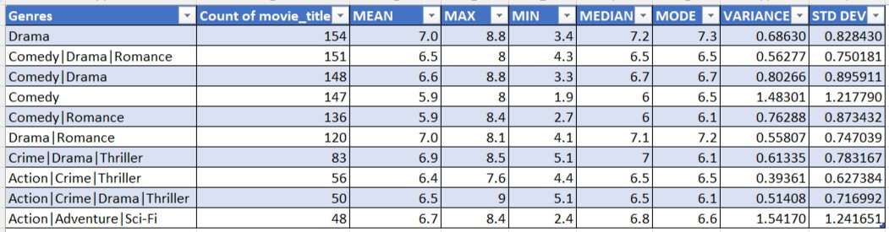
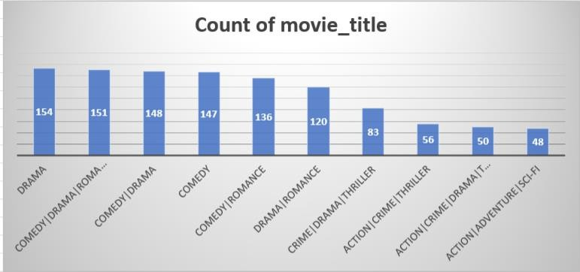
A. Movie Genre Analysis: Analyze the distribution of movie genres and their impact on the IMDB score.
Task: Determine the most common genres of movies in the dataset. Then, for each genre, calculate descriptive statistics (mean, median, mode, range, variance, standard deviation) of the IMDB scores.
The IMDb movie ratings show that drama and drama-romance movies usually get the highest scores, meaning people like them the most. Crime and thriller movies also do well. Pure comedies often get lower ratings and have mixed reviews — some are great, but many don’t do well. Action and sci-fi movies can be big hits or big misses, so they’re less predictable.
Overall, adding drama or romance seems to make movies more popular. So, if someone wants
to make a well-liked movie, choosing strong stories with drama or thrillers is a safer bet than making only comedies.

Slide 52
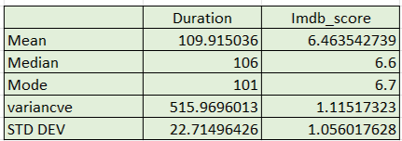
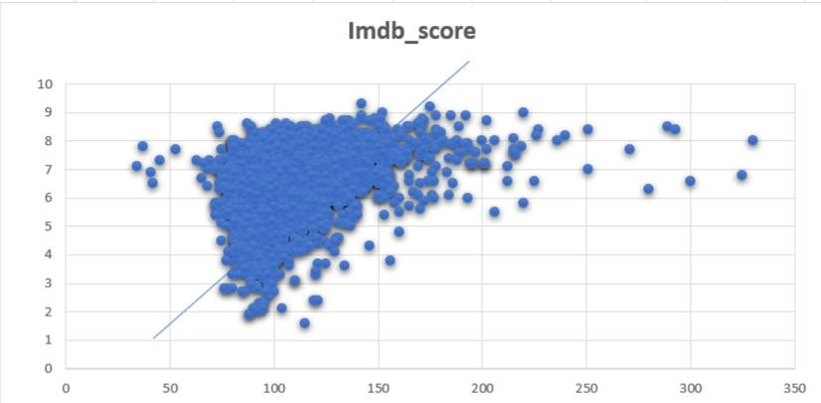
B. Movie Duration Analysis: Analyze the distribution of movie durations and its impact on the IMDB score.
Task: Analyze the distribution of movie durations and identify the relationship between movie duration and IMDB score.
The average movie in this dataset is about 110 minutes long, with most movies around 106 minutes. Many movies have a runtime close to 101 minutes, showing that movies tend to stay near the 1.5–2 hour mark. The average IMDb score is about 6.5, with most movies rated between 6.6 and 6.7. This means most movies are rated as average to good. The variation in scores is low, so ratings don’t change wildly. Overall, movies are mostly of medium length and get decent but not outstanding audience scores.

Slide 53
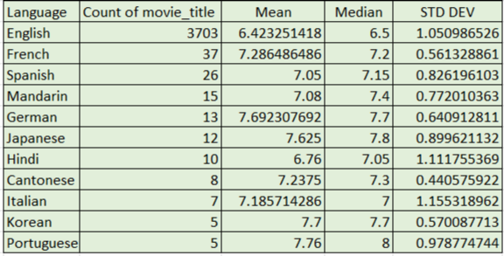
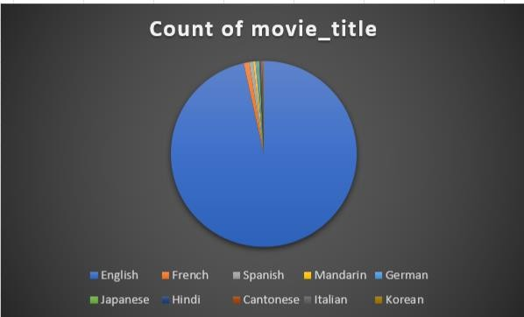
C. Language Analysis: Situation: Examine the distribution of movies based on their language.
Task: Determine the most common languages used in movies and analyze their impact on the IMDB score using descriptive statistics.
English movies make up most of the dataset but have a lower average score (6.4) compared to movies in other languages. Movies in French, German, Japanese, Korean, and Portuguese have higher average IMDb scores, mostly above 7.5, showing they are often well-received.
German and Portuguese movies top the list with averages near 7.7–7.8 and high medians too.
Hindi movies have a slightly above-average score of 6.7. Overall, while Hollywood produces
the most films, smaller sets of foreign-language films tend to score higher, suggesting they’re often more appreciated by viewers.
English movies have the widest variation in ratings, showing both hits and flops. Smaller language groups like German, French, and Cantonese have lower standard deviations, meaning their ratings are more consistent. Italian and Hindi films show mixed reviews, but overall, foreign-language movies tend to get steadier audience scores.

Slide 54
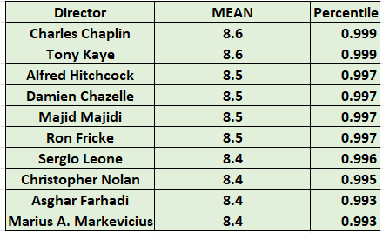
D. Director Analysis: Influence of directors on movie ratings.
Task: Identify the top directors based on their average IMDB score and analyze their contribution to the success of movies using percentile calculations.
Directors like Charles Chaplin and Tony Kaye score an average IMDb rating of 8.6, putting them in the top 90th percentile of all directors — meaning their movies are among the best rated.
Big names like Hitchcock and Nolan also rank high with scores above 8.4. These directors have high scores because they tell unique stories, create memorable characters, and often make
movies that stand the test of time. They rarely make bad films, so people trust their work.
Their movies often have strong plots, good acting, and emotional impact, which keeps their ratings consistently high.
Charles Chaplin is loved for timeless classics like Modern Times and The Great Dictator. Tony Kaye is known for American History X, a powerful drama. Alfred Hitchcock made legendary
thrillers like Psycho and Rear Window. Damien Chazelle directed the award-winning La La Land and Whiplash. Majid Majidi’s Children of Heaven is an acclaimed Iranian film. Ron Fricke created stunning documentaries like Baraka. Sergio Leone is famous for westerns like The Good, the Bad and the Ugly. Christopher Nolan made hits like Inception and The Dark Knight. Asghar Farhadi directed A Separation. Marius A. Markevicius made The Other Dream Team.

Slide 55
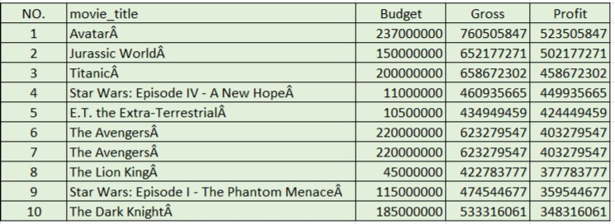
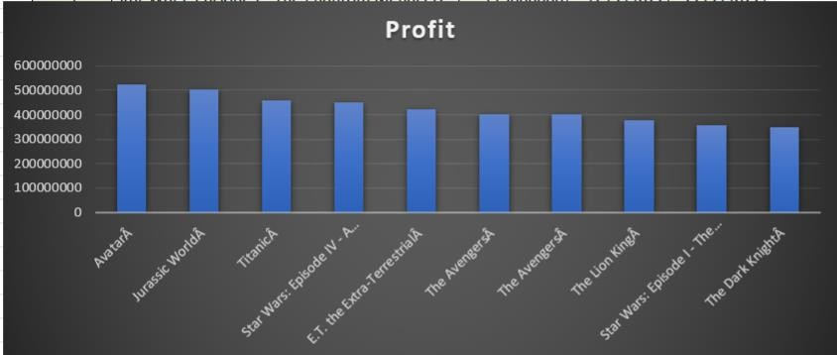
E. Budget Analysis: Explore the relationship between movie budgets and their financial success.
Task: Analyze the correlation between movie budgets and gross earnings, and identify the movies with the highest profit margin.Remember, these tasks are designed to progressively explore different aspects of the dataset and uncover meaningful insights. Each task builds upon the previous one to provide a comprehensive analysis of the IMDB movie data.
This list shows blockbuster movies that earned huge profits. Avatar leads with over $520 million profit, showing how big-budget films can pay off. Jurassic World and Titanic follow
close behind with massive earnings. Interestingly, older classics like Star Wars: A New Hope
and E.T. made huge profits with much smaller budgets, proving that great stories can succeed without massive spending. Animated hit The Lion King and superhero movies like The Avengers and The Dark Knight also made strong profits. Overall, successful movies often mix big budgets, famous franchises, and universal appeal to reach large audiences and earn huge returns.
Movies with bigger budgets often earn bigger profits, as seen with Avatar, Jurassic World, and Titanic. However, some films like Star Wars: A New Hope and E.T. made huge profits despite smaller budgets, showing that a good story and strong audience connection can deliver big returns without needing massive spending.
Big-budget films like Avatar, Jurassic World, and Titanic show that spending more can bring huge profits — but it’s not just the money. These movies also have visionary directors: James Cameron (Avatar, Titanic) is known for creating groundbreaking hits. Star Wars (A New Hope, The Phantom Menace) under George Lucas proves that an iconic story and creative direction can make huge profits even with a modest budget. Spielberg’s E.T. and Nolan’s The Dark Knight show how skilled directors turn strong ideas into blockbuster successes. So, budget helps, but the director’s talent and storytelling make the real difference.

Slide 56
Thank You

Slide 57
Bank Loan Case Study
Presented By : Rahul Vishwakarma

Slide 58
Project Description
As a data analyst at a finance company that provides various types of loans to urban customers. One of the key challenges we face is identifying applicants who are likely to default on their loans—especially those with limited or no credit history. These cases often lead to financial losses when high-risk applicants are mistakenly approved.
When a customer applies for a loan, the company faces two major risks:
If a capable applicant is rejected, we lose potential business.
If a high-risk applicant is approved and defaults, it results in a financial loss.
To address this, I am performing Exploratory Data Analysis (EDA) on a dataset containing information about loan applications. The dataset includes two categories:
Customers with payment difficulties – customers who made at least one late payment (over X days) in the first Y installments.
Other cases – customers who paid on time.
Each loan application has one of the following outcomes:
Approved – loan sanctioned.
Cancelled – customer withdrew during the process.
Refused – application rejected.
Unused Offer – loan approved but not taken by the customer.

Slide 59
Objective:
The aim of this project is to analyze how customer and loan attributes influence the risk of default. Through EDA, I am identifying trends and patterns that indicate whether a customer may struggle with repayments.
Business Objectives:
Detect key indicators of loan default based on applicant characteristics.
Support smarter approval decisions by identifying risky profiles early.
Reduce financial losses and improve the overall lending strategy.
This analysis helps the company make better decisions, such as denying high-risk loans, adjusting loan amounts, or offering higher interest rates to risky customers. It also ensures that capable applicants are not mistakenly rejected, which helps grow the business without increasing default risk.

Slide 60
All the analysis has been performed in excel. This tool is also used to create graphical representation of the results and to understand the result set better.

Slide 61
Handling Missing Values
1.Count of Missing Values:
used the COUNTBLANK function in Excel to calculate the total number of blank (null) values in each column.
Percentage of Missing Values:
calculated the percentage of missing values for each column using the formula:
= (Number of Missing Values in the Column / Total Row Count) * 100
Column Elimination Based on Missing Data:
Columns with more than 33% missing values were dropped from the dataset, as they were considered to have
insufficient data for meaningful analysis.
For columns with less than 33% missing values, I applied data imputation techniques to handle the missing entries.
Imputation Techniques Used:
Mean : For continuous numerical columns.
Median : For skewed numerical data.
Mode : For categorical variables.
This approach helped retain the integrity of the dataset while minimizing data loss and ensuring better model reliability
in further analysis.

Slide 62
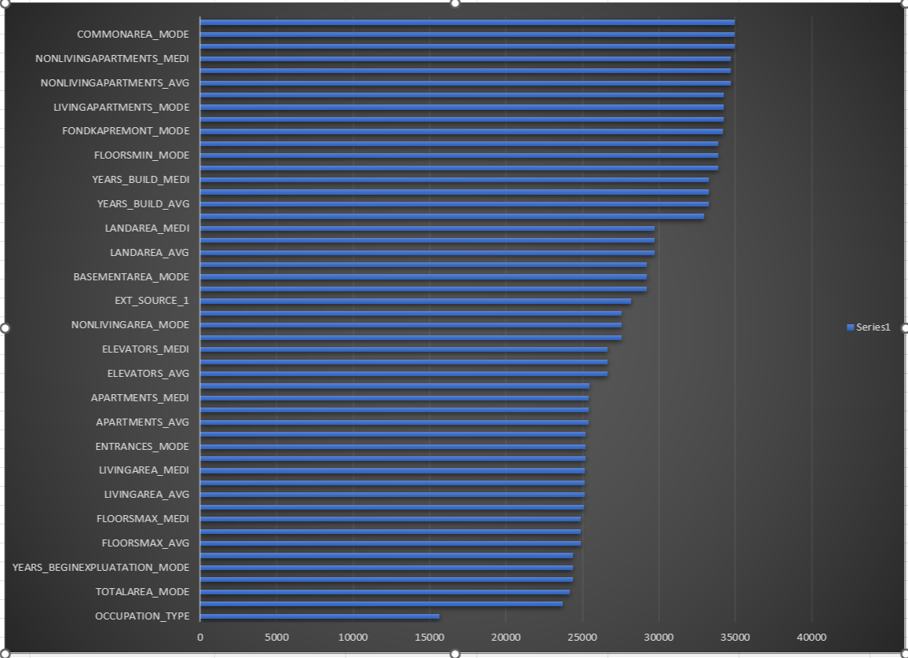
Removed Column

Slide 63
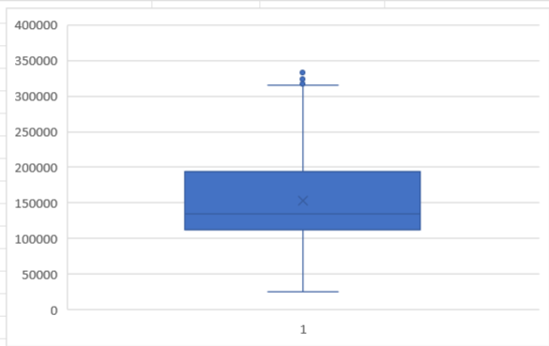

OUTLIERS
AMT_INCOME_TOTAL
The data shows Quartile 1 at ₹1,12,500 and Quartile 3 at ₹2,02,500, with an interquartile range of ₹90,000. The boxplot reveals a right-skewed distribution, with most values clustered below ₹2,00,000. There are a few higher values approaching the upper limit, indicating possible mild outliers.

Slide 64

OUTLIERS
DAYS_EMPLOYED(YR)
After analyzing the data for years of employment, I found that most people have only worked for a few years, with the median being 6 years. The minimum is 0 years, which could indicate someone just started, while the maximum is an unrealistic 1,001 years—clearly a major error in the data. The average (mean) is extremely high at 184 years; this is also because of these incorrect outlier values. Most values actually fall below 16 years, and only a few extreme data points are distorting the overall picture.
The data set for employment years has major outliers and mistakes that make the average misleading. Most people have worked for less than 16 years, but impossible values (like 1,001 years) need to be fixed or removed for the analysis to be useful.

Slide 65

OUTLIERS
DAYS_BIRTH(YR)
The analysis of the DATS_BIRTH data reveals that most values are concentrated between 34 and 54, as indicated by the interquartile range. The mean (44), median (43), and mode (30) suggest a fairly symmetrical distribution, with a minimum of 21 and a maximum of 69. The boxplot does not show significant outliers and confirms that most data points are close to the center, with only a few at the extremes. Overall, the distribution appears balanced, and there are no serious anomalies. In conclusion, this dataset presents a reliable and typical distribution, making it suitable for further analysis or decision-making

Slide 66


OUTLIERS
CNT_CHILDREN
By looking at the number of children (CNT_CHILDREN) in this data, it's clear that most people have no children, and only a smaller group have one or two. A very tiny number have more than five children, and the highest is 11, which is very rare. The average number of children is less than one, showing that having no or just one child is most common. Most of the data is tightly grouped at the low end, and the spread (variation) is small, though there are a few unusual cases with many children. In conclusion, this group mainly consists of people with few or no children, and only a handful of families are larger outliers

Slide 67


OUTLIERS
AMT_CREDIT
Looking at the credit amount data (AMT_CREDIT), most people in this group get credits between ₹2,70,000 and ₹8,08,650, with an average of around ₹5,99,700. The middle value is slightly lower at ₹5,14,777, which means many people receive amounts below the average due to a few very large credits pulling the mean up. The smallest credit is ₹45,000, while the largest is ₹40,50,000, but such high values are extremely rare and can be seen as outliers. Overall, most people get moderate-sized credits, and only a handful get unusually large amounts, so the main takeaway is that typical credit amounts are clustered in the lower range, with few exceptions

Slide 68


Data Imbalance
The loan application dataset shows a strong data imbalance between classes. About 92% of records belong to class 0 (no default) and only 8% to class 1 (default), as reflected in both the summary table and the pie chart. This means the vast majority of applicants do not default, while a small portion do. Such an uneven distribution may impact the performance of predictive models, making them biased toward predicting the majority (non-default) class. To ensure accurate and fair results, it is important to address this imbalance—using techniques like oversampling the minority class, undersampling the majority, or applying specialized algorithms for imbalanced data.

Slide 69


Data Imbalance
The loan application dataset shows a strong data imbalance between classes. About 92% of records belong to class 0 (no default) and only 8% to class 1 (default), as reflected in both the summary table and the pie chart. This means the vast majority of applicants do not default, while a small portion do. Such an uneven distribution may impact the performance of predictive models, making them biased toward predicting the majority (non-default) class. To ensure accurate and fair results, it is important to address this imbalance—using techniques like oversampling the minority class, undersampling the majority, or applying specialized algorithms for imbalanced data.

Slide 70


UNIVARIATE ANALYSIS
Looking at the income data, most people have incomes between ₹85,650 and ₹175,650. The highest group is ₹85,650–₹115,650, with over 10,000 records. Very few people have incomes above ₹385,650, and hardly anyone earns more than ₹505,650. This means the majority of people in the dataset fall into the low to middle-income ranges, with only a small number earning very high incomes.
In conclusion, the income data is mostly concentrated in the low to middle ranges, with very few people earning high incomes.

Slide 71




UNIVARIATE ANALYSIS
Looking at the types of loans, most people in the dataset have taken cash loans, making up about 91% of all loans. Only a small portion, around 9%, have chosen revolving loans. This shows a very strong preference for cash loans among the applicants. Because cash loans are much more common, most patterns or trends you find in the data will be about cash loans.
The family status of people who applied for loans, most applicants are married—this group is much bigger than any other, with over 32,000 records. Single people and those in a civil marriage come next but have much smaller counts. Separated and widow categories have the fewest applicants. This tells us that married people make up the largest share of loan customers, while widows and separated people are least common

Slide 72




UNIVARIATE ANALYSIS
The education types of people in this dataset, the vast majority have finished secondary (high school) education—almost 36,000 out of 50,000 records. Higher education, like college or university, is the next most common, but there are only about 12,000 people in this group. Very few people have an academic degree (like a PhD), lower secondary education, or incomplete higher education. This means most people who applied have just a basic school education, and only a small number went on to advanced or university-level studies.
the education types of people in this dataset, the vast majority have finished secondary (high school) education—almost 36,000 out of 50,000 records. Higher education, like college or university, is the next most common, but there are only about 12,000 people in this group. Very few people have an academic degree (like a PhD), lower secondary education, or incomplete higher education. This means most people who applied have just a basic school education, and only a small number went on to advanced or university-level studies.

Slide 73


Segmented Univariate Analysis
From the income-wise segmentation, it is observed that customers with an income between ₹85,650 and ₹1,15,650 form the largest group and also have a high number of defaults (882 cases). The default rate seems to increase slightly in middle-income groups and then decline in higher-income brackets. The lowest number of defaults is seen in the highest income group (>₹5,05,650), indicating that higher-income customers are less likely to default. This suggests a trend where default risk is higher in the mid-income segments, and the company should be more cautious while approving loans in those income ranges.

Slide 74




Segmented Univariate Analysis
Looking at both gender and loan default status, we see that most people—whether male or female—do not default on their loans. Among females, about 93% did not default, while only 7% did. Among males, 90% did not default, and 10% did. There are more females in the data overall, but in both groups, defaulting on a loan is still quite rare. This means that, regardless of gender, most applicants pay back their loans, although a slightly higher percentage of males default than females
When we look at the types of loans and whether people defaulted, most people in both groups did not default. For cash loans, out of about 45,000 applications, only around 3,800 ended in default, while for revolving loans, just 234 defaulted out of about 4,700. This means defaults are uncommon for both loan types, but cash loans are much more popular—almost ten times more common than revolving loans. So, no matter the loan type, paying back is the usual result, but cash loans make up the biggest part of the dataset.

Slide 75


Bivariate Analysis
When we look at the data grouped by income and split it by gender, we see that most people in every income category are females, especially in the middle-income brackets. Within each income group, both males and females usually pay back their loans—defaults are low for everyone. For example, in the ₹85,650 to ₹145,650 range, non-defaulters are much more common than defaulters for both genders. High-income groups (above ₹385,650) have very few people, and in these categories, almost no one defaults. The vast majority of applicants, whether male or female, come from low and middle-income groups. Also, across all these segments, it is clear that paying back the loan on time is the most frequent result. This shows that gender or income level doesn’t make a big difference in whether people repay loans—defaults are always the exception, not the rule.

Slide 76


Bivariate Analysis
When we look at the average credit amount given to people in each income group, there’s a clear pattern: as income increases, the average loan amount also goes up. People in the lowest income range (₹25,650–₹55,650) get an average credit of about ₹3 lakh, while those with the highest incomes (above ₹5 lakh) get loans averaging over ₹11 lakh. Most people fall into the low to middle-income ranges, where the average credit is between ₹3 lakh and ₹8 lakh. Only a small number of people are in the high-income groups, but they receive much larger loans. This shows that banks or lenders are willing to offer higher loan amounts to people who have bigger incomes, probably because they are more likely to pay it back. Overall, most loans are of moderate size, and only a few very high-income individuals get very large credits.

Slide 77

Bivariate Analysis
Moderate to Weak Relationships:
Strong Positive Relationships:
Some features, like loan amount (AMT_CREDIT) and goods price (AMT_GOODS_PRICE), are very closely related. Since they carry similar information, we may not need both in the final model.
The relationships between income, loan amount, and annuity show that a customer’s financial strength plays an important role in loan approval.
Features like age and employment duration also show clear patterns—older people usually have longer work histories and may be more stable. This is useful in identifying low-risk borrowers.
Family details (like number of children and family members) and region-related data can also offer helpful insights, but they might need more analysis before being used directly.
AMT_CREDIT and AMT_GOODS_PRICE (0.98):
This indicates that loan are often taken specifically to finance goods, suggesting predictable and structured borrowing behavior.
AMT_ANNUITY with AMT_GOODS_PRICE (0.78):
This is expected, as annuity payments depend both on loan amount and repayment terms.
AMT_CREDIT and AMT_ANNUITY (0.77):
Higher loan amounts naturally result in higher annuity payments. This supports the assumption that annuity can be a good proxy for loan size.
AMT_INCOME_TOTAL shows moderate correlations with AMT_ANNUITY (0.45) and AMT_GOODS_PRICE (0.38):
While not extremely high, this suggests income levels impact the size of the loan and the nature of goods financed.
CNT_CHILDREN and CNT_FAM_MEMBERS (0.88):
Families with more children naturally have more family members. These two features are highly related, and one might be dropped during modeling to avoid multicollinearity.
REGION_RATING_CLIENT and POPULATION_RELATIVE (-0.54):
Customers in higher-rated regions tend to live in less densely populated areas. This may reflect better living conditions or more rural/suburban environments.

Slide 78

Bivariate Analysis
Strong Positive Relationships:
Strong correlation exists between AMT_CREDIT and AMT_GOODS_PRICE (0.98), showing defaulters borrow almost the full value of goods.
CNT_CHILDREN and CNT_FAM_MEMBERS are highly correlated (0.89), indicating redundancy.
Weak relationships between AMT_INCOME_TOTAL and loan-related variables suggest income is not a strong predictor of default.
DAYS_BIRTH and DAYS_EMPLOYED show moderate correlation (0.58), implying older people tend to have longer work history—even among defaulters.
Regional rating is negatively correlated with population density (-0.42), meaning better regions are less crowded—but this has unclear impact on default behavior.

Slide 79
The bank must give special attention to outliers in employment years and income data, as they can skew analysis and affect risk assessment. Due to the imbalanced dataset, modeling should use proper techniques like oversampling, undersampling, or specialized algorithms to avoid bias toward non-defaulters. Many defaulters fall within the middle-income group, highlighting the need for extra checks for applicants earning between ₹85,650 and ₹1,15,650. The strong correlation between loan amount and goods price indicates that most loans are taken to buy specific items—this can help predict the purpose of the loan. Features like income, age, and employment show weak or unclear patterns among defaulters, so loan approval should not depend on these alone. Customers with shorter work history or unrealistic employment records (like 1,001 years) must be reviewed or flagged automatically. Although married applicants dominate the dataset, male clients show a slightly higher default rate and may require deeper profiling. Clients from densely populated but high-rated regions still appear in the defaulter group, suggesting demographic data needs further review. Most defaulters prefer cash loans, so stricter risk checks should be applied to this product type.
Conclusion

Slide 80
Thank You

Slide 81
Impact of Car Features on Price and Profitability
Presented By : Rahul Vishwakarma

Slide 82
Project Description
The automotive industry is rapidly evolving with a focus on:
Fuel efficiency
Environmental sustainability
Technological innovation
Consumer preferences are shifting due to:
Rising interest in electric, hybrid, and alternative fuel vehicles
Sustained demand for traditional gasoline-powered cars
Business Problem
Understanding how various car features influence pricing and profitability is critical for automotive manufacturers
and dealers aiming to make informed, data-driven decisions. By identifying which attributes most significantly impact
vehicle pricing and drive profitability, companies can refine their product development, marketing strategies, and sales approaches.
This analysis will uncover the key features that contribute to higher value, enabling manufacturers to strategically optimize their offerings
to align with market demand and maximize returns.

Slide 83
APPROACH:
After downloading the dataset, I began by selecting the entire data range and inserting it into an Excel table for better handling and organization. I then converted the table back to a normal range to enable flexible data cleaning operations. Using the =COUNTBLANK formula, I identified and removed any blank or empty columns that did not contribute meaningful information. As a result of this initial cleaning process, the final dataset consists of 11,813 rows and 16 well-defined columns, ready for further analysis.
I applied a comprehensive data analysis strategy combining multiple analytical methods to derive meaningful insights from the dataset:
Descriptive Analysis: Calculated the mean and other statistical measures for numerical variables to understand the central tendency and distribution.
Predictive Analysis: Performed linear regression to evaluate how different features influence car pricing and to forecast pricing trends.
Diagnostic Analysis: Conducted correlation analysis to identify relationships between key variables and determine which features are most strongly associated with price.
Exploratory Data Analysis (EDA): Used various visualization techniques—including scatter plots, bubble charts, and distribution charts—to uncover patterns, outliers, and data trends.
This multi-layered analytical approach enabled a deeper understanding of the dataset and supported evidence-based decision-making for pricing and product development.

Slide 84
All the analysis has been performed in excel. This tool is also used to create graphical representation of the results and to understand the result set better.

Slide 85


Task 1.A: Create a pivot table that shows the number of car models in each market category and their corresponding popularity scores.

Slide 86

Task 1.B: Create a combo chart that visualizes the relationship between market category and popularity.

Slide 87
INSIGHTS :-
Certain car types like “Hatchback, Flex Fuel”, “Flex Fuel, Diesel”, and “Crossover, Flex Fuel, Performance” have very few models available, but they are extremely popular among buyers. This means that even though choices in these types are limited, demand is high for what does exist.
The crossover segment is the largest with 1,103 different models, showing it’s the most widely available and possibly the most versatile choice for buyers.
Cars labeled “Exotic” or “Luxury” often have much lower popularity. This could be because these vehicles usually come with very high price tags, making them affordable only for a few wealthy buyers.
For example, the “Crossover, Luxury, Performance, Hybrid” category only has 2 models, but it’s highly popular (popularity score: 3916). This tells us that when a rare combination of features hits the market, many people want it.
Similarly, luxury model types like “Hybrid, Performance, Hybrid”, “Flex Fuel, Factory Tuner, Luxury, High-Performance”, and “Crossover, Exotic, Luxury, Performance” have only a single model each, making them rare finds. Even with just one option, they attract attention—especially if it covers multiple desirable features.
Models that combine many features like “Crossover, Exotic, Luxury, High-Performance” and “Exotic, Luxury, High-Performance” are very rare, with just one model available in the market. Such cars are often exclusive and target a small segment of buyers.
While car buyers have many choices, the most common types (like crossovers) dominate the market. However, some rare models with niche combinations of features are in high demand even if only a few exist. Expensive luxury and exotic cars tend to be less popular, probably because they are out of reach for most people.

Slide 88

Task 2: Create a scatter chart that plots engine power on the x-axis and price on the y-axis. Add a trendline to the chart to visualize the relationship between these variables.

Slide 89
INSIGHTS :-
Cars with higher engine horsepower (HP) usually have a higher price (MSRP), but the relationship isn’t very strong—there are many exceptions.
Most cars cluster on the left and lower part of the chart, meaning most vehicles have lower horsepower and cost less.
A few cars with extremely high horsepower (over 650 HP, up to about 1000 HP) are priced much higher—some even cost over 2 million! These are likely supercars or premium models.
For the same horsepower, car prices can vary a lot, showing that other features (brand, luxury, design, technology) also influence price.
There are a few cars with much higher prices than others for their horsepower, suggesting that rarity or luxury influences price more than just engine power.
In the scatter plot graph trendline moving upward and it is showing the positive relationship between price and engine power, it means as the engine power increasing price is also increasing.

Slide 90





Task 3: Use regression analysis to identify the variables that have the strongest relationship with a car's price. Then create a bar chart that shows the coefficient values for each variable to visualize their relative importance.

Slide 91
INSIGHTS :-
Based on the regression analysis, we found that Engine Horsepower, Engine Cylinders, Highway MPG, and City MPG all have a positive and important connection with car prices.
Cars with more engine horsepower usually cost more. The more powerful the engine, the higher the price.
Cars with more engine cylinders tend to be cheaper in this model. This might be because today’s luxury cars don’t rely on cylinder count for cachet.
Cars with more doors (like 4-door sedans) typically cost less. Sportier, more expensive cars often have only two doors.
Cars with good city fuel economy also have higher prices—good mileage is valuable.
The more popular a car is, the less it tends to cost, likely because popular cars are mass-produced and more affordable.
In the graph, Engine Cylinders show the strongest positive link to price, meaning more cylinders usually mean a higher price.
On the other hand, the Number of Doors has the strongest negative connection, which means that as the number of doors increases, the car price tends to go down.

Slide 92



Task 4.A: Create a pivot table that shows the average price of cars for each manufacturer. Task 4.B: Create a bar chart or a horizontal stacked bar chart that visualizes the relationship between manufacturer and average price.

Slide 93
INSIGHTS :-
Some car brands have much higher average prices than others. For example, Plymouth has an average price of just $3,123, while Bugatti tops the list with $1,757,223!
Brands like Bugatti, Maybach, Rolls-Royce, Lamborghini, Bentley, and Ferrari are by far the most expensive. These are known for luxury, exclusivity, and high performance.
Popular brands like Honda, Toyota, Ford, Hyundai, Kia, and Nissan have average prices between $20,000 and $30,000, making them much more affordable for the average person.
Brands such as BMW, Audi, Cadillac, and Mercedes-Benz sit in the middle range—they’re more expensive than basic brands but still far less than the ultra-luxury names.
Cars from brands like Bugatti, Maybach, and Rolls-Royce have prices that are off the charts compared to all other cars. These are special cars aimed at super-rich buyers.
Even though we hear a lot about luxury brands, most cars people buy are from the cheaper, everyday brands.
When you average all the brands together, the typical car costs about ₹40,560, but this number is pulled up by the very high prices of a few luxury brands.
High-end brands charge much more because of luxury features, brand prestige, and limited production. Cheaper brands focus on affordability and practicality.

Slide 94


Task 5.A: Create a scatter plot with the number of cylinders on the x-axis and highway MPG on the y-axis. Then create a trendline on the scatter plot to visually estimate the slope of the relationship and assess its significance.
The scatter plot clearly shows that as the number of engine cylinders goes up, a car’s highway MPG usually goes down. This means cars with bigger engines (more cylinders) are generally less fuel-efficient on highways.
The trendline in the plot slopes downward, showing this negative relationship. The drop isn’t subtle—there’s a strong and noticeable decrease in MPG with each step up in cylinder count.
The spread of the dots clusters nicely around the trendline, which suggests this is a real, consistent trend and not a random pattern.

Slide 95
Task 5.B: Calculate the correlation coefficient between the number of cylinders and highway MPG to quantify the strength and direction of the relationship.
Strong Negative Correlation:
The correlation coefficient (a number that measures how strong and in which direction two things are related) between number of cylinders and highway MPG is about -0.62.
The negative value tells us “as one goes up, the other goes down.”
The size of the number (-0.62) means the link is fairly strong, but not perfect. So, engine cylinders do a good job predicting highway MPG for most cars.
Cars with more engine cylinders are usually a lot less efficient on the highway. If you want to save fuel and money, go for a car with fewer cylinders.

Slide 96



Task 1: How does the distribution of car prices vary by brand and body style?
I have calculated the total car prices (MSRP) for each combination of body style and brand name. Next, I created column charts that display how car prices are distributed across different brands and body styles. Also, I added a slicer to the chart, which lets you filter and view the data by different vehicle styles.

Slide 97

Task 2: Which car brands have the highest and lowest average MSRPs, and how does this vary by body style?
Bugatti has the highest average car price for coupes compared to any other brand, with Maybach taking the second spot for convertibles.
On the other hand, Plymouth offers the lowest average prices of all the car brands.

Slide 98

Task 3: How do the different feature such as transmission type affect the MSRP, and how does this vary by body style?
Cars with automatic gears usually cost more than manuals because automatics are fancier and easier to drive.
Manuals are cheapest and mostly found in hatchbacks and basic sedans. Go for these if you want to save money.
Special gears like AMT and direct drive are usually priced between manuals and automatics, but sometimes cost more in luxury cars.
Automated manual transmissions are only found in top luxury brands like Bugatti, Maybach, Lamborghini, Ferrari, and Bentley. Cars with this type of transmission also have a very high average price.
In SUVs and luxury cars, automatics are almost standard, so these types are pricier.
If you pick an automatic in a cheaper body style, you'll still pay more than for a manual.
Bottom line: Automatic = more expensive, manual = cheaper, and your choice also depends on what type of car you buy.

Slide 99

Task 4: How does the fuel efficiency of cars vary across different body styles and model years?
4-door hatchbacks have the best fuel efficiency, getting close to 38 km per liter—higher than all other body styles.
2-door hatchbacks are also excellent when it comes to mileage, taking the second spot.
Sedans rank just after hatchbacks, also offering very good fuel economy.

Slide 100
INSIGHTS :-
Smaller cars like hatchbacks and compact sedans are generally the most fuel-efficient, often getting more than 18–20 km/l, while SUVs and big cars usually have lower mileage unless they’re hybrids.
Over the years, cars have gotten more fuel-efficient. Newer models today use less fuel thanks to better engines, lighter materials, and more hybrid options compared to cars from 20 years ago.
Sports cars, luxury sedans, and big SUVs are usually less fuel efficient.
Hybrids and CNG cars give the best mileage, even when they’re bigger; some midsize hybrid SUVs now go over 27 km/l.
Pickup trucks and vans are usually the least efficient but have improved with diesel engines or hybrid tech in newer models.
There’s a clear trend: fuel efficiency keeps getting better every year, mainly because of advances in technology and stricter rules.
Electrification—such as hybrid and electric vehicles—pushes mileage even higher, helping big cars get closer to small-car fuel economy.
If you want to save on fuel, choose a small hatchback or a hybrid. Trucks and SUVs will use more fuel, but choosing a newer model or hybrid can help lower costs.
No matter the body style, buying a newer car almost always means better mileage than an old one.

Slide 101

Task 5: How does the car's horsepower, MPG, and price vary across different Brands?
4-door hatchbacks have the best fuel efficiency, getting close to 38 km per liter—higher than all other body styles.
2-door hatchbacks are also excellent when it comes to mileage, taking the second spot.
Sedans rank just after hatchbacks, also offering very good fuel economy.

Slide 102
INSIGHTS :-
Car brands vary widely in horsepower, MPG (mileage), and price.
Luxury brands like Bugatti, Lamborghini, and Ferrari top the charts for horsepower, often well above 1,000 hp, and have the highest prices—sometimes over ₹1 crore or even more.
Mainstream brands like Toyota, Honda, Hyundai, Kia, and Ford offer cars with more moderate horsepower—typically around 120–180 hp—and are much more affordable.
Fuel efficiency (MPG) is generally best in brands that focus on small cars and hybrids, like Toyota (Hyundei, Camry Hybrid), Maruti Suzuki, and Honda (City Hybrid), with some models achieving 23–28 km/l (about 55–65 mpg), especially in hybrid variants.
Luxury and sports brands focus less on fuel efficiency—supercars and high-performance sedans (Bugatti, Lamborghini, Bentley, Rolls-Royce) get much lower MPG, but deliver top speed and power.
Price gaps are huge: Luxury/supercar brands are in a completely different league price-wise compared to everyday brands. For example, a Bugatti can cost more than ₹1.75 crore, while cars from brands like Maruti Suzuki or Tata can start below ₹5 lakh.
Mid-range and premium brands, like BMW, Audi, and Mercedes-Benz, provide a balance. They generally offer higher horsepower and better features than entry-level brands, but with better fuel efficiency and prices still far below the supercar category.
Affordable brands offer lower power, higher mileage, and lower prices; performance and luxury brands offer high horsepower, lower mileage, and much higher prices. Brand choice dramatically affects what you get in terms of power, fuel efficiency, and cost.
High-end brands like Bugatti and Maybach have higher horsepower and prices, while brands like Suzuki focus on fuel efficiency and higher mileage. Generally, as horsepower increases, so does price. In some brands, higher MPG means lower prices. BMW offers top engine power but low mileage.

Slide 103
This analysis provided valuable insights into how various car features influence pricing and profitability. By applying these findings, automotive companies can make smarter decisions to optimize their product lines, pricing models, and marketing strategies, ultimately improving profitability. This report highlights the key results of the project and suggests actionable recommendations based on the data. Key findings : Luxury brands like Bugatti and Ferrari are very pricey, while brands like Toyota and Honda are affordable. Cars with fewer cylinders use less fuel, making them cheaper to run. Cars with higher horsepower tend to have higher prices and generate better profit margins, showing a clear positive impact on profitability. Features like engine power, fuel efficiency, and brand name strongly affect car prices. Fuel-efficient vehicles generally have a negative correlation with price; however, they attract a dedicated segment of buyers focused on economy and sustainability. Brand prestige is the strongest predictor of both price and profitability—cars from prestigious brands command significantly higher prices and profits. Choosing the right mix of features can help buyers save money and still get a great car. Throughout this project, I enhanced my data analysis skills using Excel tools such as regression analysis, pivot tables (for averages and sums), and visualization techniques like bubble and scatter charts. This experience greatly improved my exploratory data analysis capabilities and strengthened my ability to derive meaningful insights from complex data, helping me support sound decision-making and contribute to impactful business outcomes.
Conclusion

Slide 104
Thank You

Slide 105
ABC Call Volume Trend Analysis
Presented By : Rahul Vishwakarma

Slide 106
Project Description
This report looks closely at incoming calls to ABC Insurance to help improve how quickly and efficiently customer calls are handled.
It starts by showing the average time spent on each call during different hours of the day, helping us understand when agents are busier or more efficient.
Next, we study the number of calls during each hour, using charts to clearly show when the call center gets the most calls.
Based on this, we suggest how many agents are needed each hour to reduce the number of missed or abandoned calls to just 10%.
We also address a major issue — no agents available at night — by creating a night shift plan so customers get help even after 9 PM.
All the assumptions, steps, and calculations used in this report are clearly explained.
In short, this report gives clear ideas to help manage the call center better and keep customers happier.

Slide 107
APPROACH:
In this project, we conducted a comprehensive analysis of 23 days of inbound call data for ABC Insurance, with the goal of improving
customer service and optimizing call center operations. The analysis began by cleaning and organizing the dataset into hourly time
buckets, allowing us to examine key metrics such as average call duration, total call volume, and call status (answered, abandoned, or
transferred) across different times of the day. This helped us identify peak call hours, periods of long wait times, and inefficiencies in call
handling. Based on these insights, we developed a manpower planning strategy to reduce the call abandon rate from 30% to 10%, by
calculating the minimum number of agents needed in each time slot. We also addressed the issue of night-time call handling, estimating
agent requirements for the 9 PM to 9 AM shift based on projected call volumes. Our approach takes into account agent availability,
working hours, and performance assumptions. The findings offer practical recommendations to help ABC Insurance enhance customer
experience, ensure timely response, and improve overall operational efficiency in their call center.

Slide 108
All the analysis has been performed in excel. This tool is also used to create graphical representation of the results and to understand the result set better.

Slide 109


Average call duration: what is the average duration of calls for each time bucket?
The analysis of average call duration across different hourly time buckets revealed clear patterns in agent workload and customer interaction times. Time slots between 10AM-11AM showed the highest average call durations, indicating longer and possibly more complex customer conversations during this period. In contrast, early morning slots like 12PM-13PM showed shorter average durations, suggesting quicker resolutions or fewer detailed inquiries.
These findings suggest that agents may need additional support or expertise during mid-day hours to handle higher call complexity efficiently. Adjusting manpower or providing specialized training during these peak duration periods could lead to better call handling and reduced wait times.

Slide 110


Call Volume Analysis: Can you create a chart or graph that shows the number of calls received in each time bucket?.
The highest call volumes occurred between 12 PM and 1 PM, indicating peak customer activity during mid-day hours. Early mornings and evenings had lower traffic. These patterns highlight the need for more agents during peak hours and fewer during quieter periods to optimize staffing and improve customer response time.

Slide 111




Manpower Planning: What is the minimum number of agents required in each time bucket to reduce the abandon rate to 10% ?
To reduce the call abandon rate from 30% to the target of 10%, a total of 57 agents are required across the day shift (9 AM to 9 PM). The required number of agents per hour is calculated based on actual call volume and average call duration in each time bucket. This Heat map size Represent number of agent required.

Slide 112



Night Shift Manpower Planning: Propose a manpower plan for each time bucket throughout the day, keeping the maximum abandon rate at 10%.
To ensure customer support is available 24/7 and maintain the maximum abandon rate at 10%, a night shift manpower plan has been proposed for the 9 PM to 9 AM window.
The total number of additional agents required is 17, distributed across each hourly time bucket based on projected call volume (assumed to be 30% of daytime calls).
The exact number of agents needed for each hour is shown in the "Agent no." column of the table. This plan ensures better customer experience during off-hours and helps reduce frustration caused by unanswered night-time calls.

Slide 113
This analysis provides a data-driven approach to improve call center efficiency and customer satisfaction at ABC Insurance. By examining call volume, average handling time, and agent capacity, we identified key peak hours and staffing gaps. A detailed manpower plan was proposed for both day and night shifts to reduce the abandon rate from 30% to the targeted 10%. Implementing these recommendations will help optimize resource allocation, ensure timely responses, and enhance overall customer experience. With proper execution, the call center can achieve better performance, reduced wait times, and stronger customer trust.
Conclusion

Slide 114
Thank You

